Slide 1

EMPLOYEE DATA ANALYSIS Using EXCEL
STUDENT NAME: J.R.SHREE LAKSHMI REGISTER NO: 312211202 6B39A5D770E8AA7992E47B7C81502485 DEPARTMENT: BCOM (BANK MANAGEMENT)
COLLEGE: DR. MGR JANAKI COLLEGE OF ARTS &
SCIENCE FOR WOMEN.

Slide 2

PROJECT TITLE - Employee Performance Analysis USING EXCEL
AGENDA :
1.Problem Statement
2. Project Overview
3. End Users
4. Our Solution and Proposition
5. Dataset Description
6. Modelling Approach
7. Results and Discussion
8. Conclusion

Slide 3
PROBLEM STATEMENT :
I struggle to effectively analyze and evaluate the performance of our employees. Our organization has a large workforce, and manually tracking individual performance metrics is time- consuming and prone to errors.We need a systematic and data-driven approach to assess employee performance, identify areas for improvement, and make informed decisions about promotions, training, and development. How can we leverage Excel to create a comprehensive employee performance analysis.
process:
1. Manual data collection and analysis.
2. Inability to track individual performance
metrics .
3. Limited visibility into employee strengths
and weaknesses.
4. Difficulty in identifying areas for
improvement .
5. Inefficient decision-making process for
promotions, training, and development.

Slide 4
WHO ARE THE END USERS?
★ Employees
★ Training and Development
Teams
★ Executive Management ★ Recruiters
★ Compensation and Benefits
Teams
★ Organizational Development
Teams

Slide 5
OUR SOLUTION AND ITS VALUE PROPOSITION
★ Conditional formatting - Missing
Filter – Remove
★ Formula - Performance
★ Pivot - Summary
★ Graph - Data visualization

Slide 6
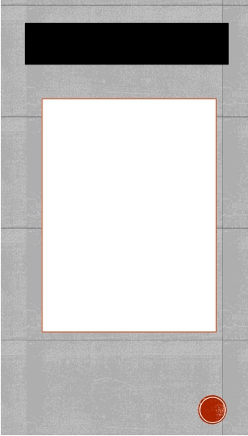
▪Dataset Description :
★ Employee = haggle ★26-features
★ 9-features
★ Employee id - number
★ Name = text
★ Performance level
★ Gender-male, female
★ Employee rating - number
THE "WOW" IN OUR SOLUTION :
DATA COLLECTION: employee datas FEATURE COLLECTION:
• edunet dashboard
DATA CLEANING:
• missing value identify & filter PERFORMANCE LEVEL:
IFS(Z8>=5,"VERY HIGH", Z8>=4,"HIGH", Z8>=3,"MED","TRUE"," LOW")

Slide 7
▪ MODELLING ▪ MODELLING
DATA COLLECTION:
• employee datas FEATURE COLLECTION:
• edunet dasboard DATA CLEANING:
• missing value identify & filter
PERFORMANCE LEVEL:
• IFS(Z8>=5,"VERY HIGH",
Z8>=4,"HIGH", Z8>=3,"MED","TRUE","LOW")
▪
▪
▪
▪
▪
▪
▪
▪
▪
VISUALIZATION:
• pivot table & chart
SUMMARY:
• exit date verification
• filter
• sciler
• pivort chart
• pivort table

Slide 8
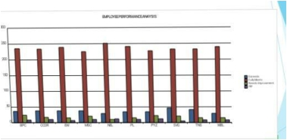
RESULTS :

Slide 9
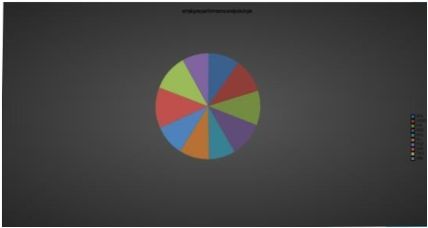
RESULTS :

Slide 10
Conclusion :
The Employee Performance Analysis using Excel project aimed to design and develop a comprehensive framework for tracking, analyzing, and evaluating employee performance metrics. The project successfully created an interactive and user-friendly Excel dashboard that enables HR managers, supervisors, and department heads to make data-driven decisions about talent management and development.

